Slide 1
Activation Functions

Slide 2
What are activation Functions??
It is also known as Transfer Function.
Activation function decides, whether a neuron should be activated or not by calculating weighted sum and further adding bias with it. The purpose of the activation function is to introduce non-linearity into the output of a neuron.

Slide 3
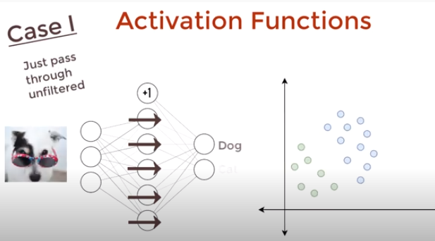
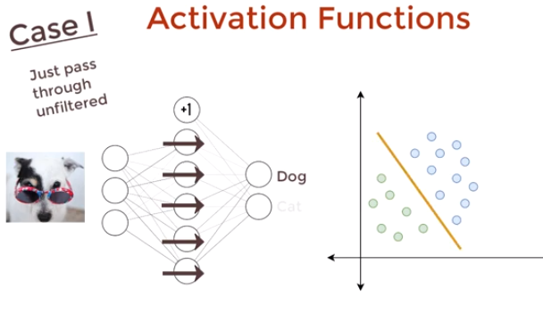
Without using activation function

Slide 4
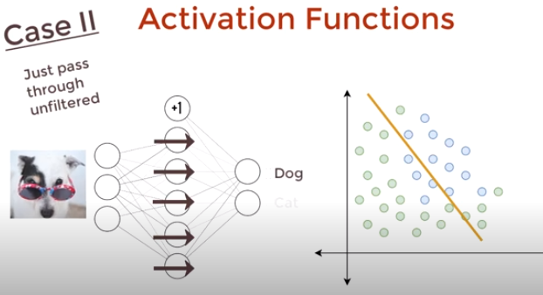
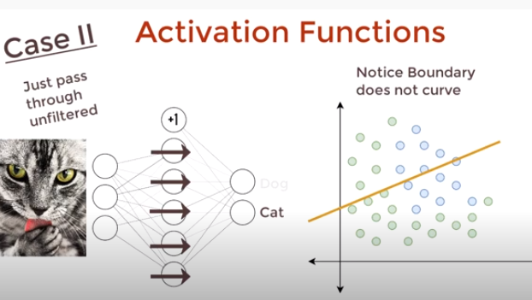
Very difficult to separate cats from dogs.. Lets try using nonlinear functions

Slide 5
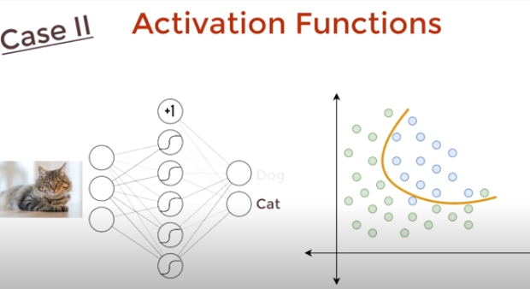
The function which is used here for classifying the data correctly is the activation function

Slide 6
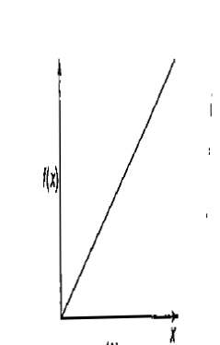
Types of Activation Functions
Identity function- it is a linear function.
f(x)= x for all x
The output here remains the same as input. The input layer uses the identity activation function

Slide 7

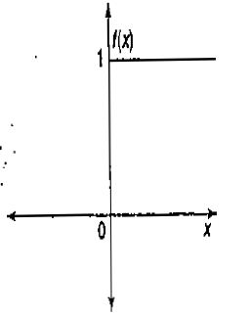
Binary Step function-
here θ represents the threshold value. This function is most widely used in single-layer nets to convert the net input to an output that is a binary (1 or 0).

Slide 8

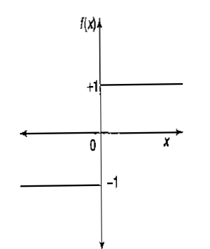
Bipolar step function:- This function is also used in single-layer nets to convert the net input to an output that is bipolar(+ 1 or -1).

Slide 9

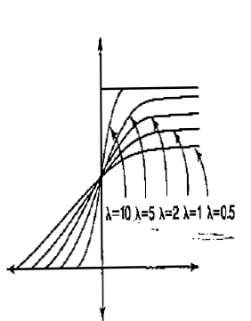
Sigmoidal functions-.
Binary Sigmoidal Function:-
It is also termed as logistic sigmoid function or unipolar sigmoid function.
here λ is steepness parameter. The range of the sigmoidal function is from 0 to 1.

Slide 10



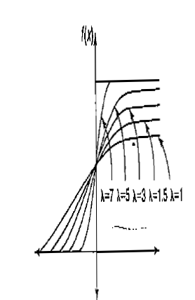
Sigmoidal functions-
Bipolar Sigmoidal function-the range of this function is between -1 and 1

Slide 11

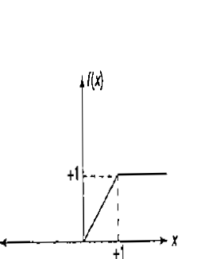
Ramp Function

Slide 12
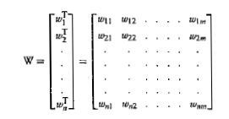
Important Terminologies of ANNs- 1. Weights
In the architecture of an ANN, each neuron is connected to other neurons by means of directed communication links, and each communication link is associated with weights
The weights contain information about the input signal. This information is used by the net to solve a problem
The weight can be represented in the form of a matrix. The weight matrix can also be called connection matrix.

Slide 13

Bias
The bias is included in the network has its impact in calculating the net input
The bias is included by adding a component xo=1 to the input vector X, Thus the input vector becomes
The bias is considered as another weight , that is w_{0j}=b
The bias can be of two types: positive bias and negative bias. The positive bias helps in increasing net input of the network and the negative bias helps in decreasing the net input of the network. Thus, as a result of the bias effect, the output of the network can be varied. ·

Slide 14
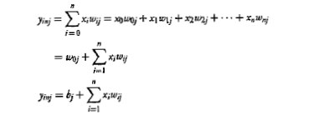

Slide 15
Threshold
Threshold is a set value based upon which the final output of the network may be calculated
The threshold value is used in me activation function.
A comparison is made between the calculated net input and the threshold to obtain the network output.

Slide 16
Learning Rate
The learning rate is denoted by α .It is used to control the amount of weight adjustment at each step of training
The learning rate, ranging from 0 to 1, determines the rate of learning at each time step.

Slide 17
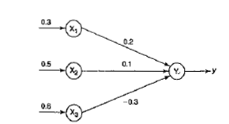
Q.1 Calculate the net input to the output neuron

Slide 18
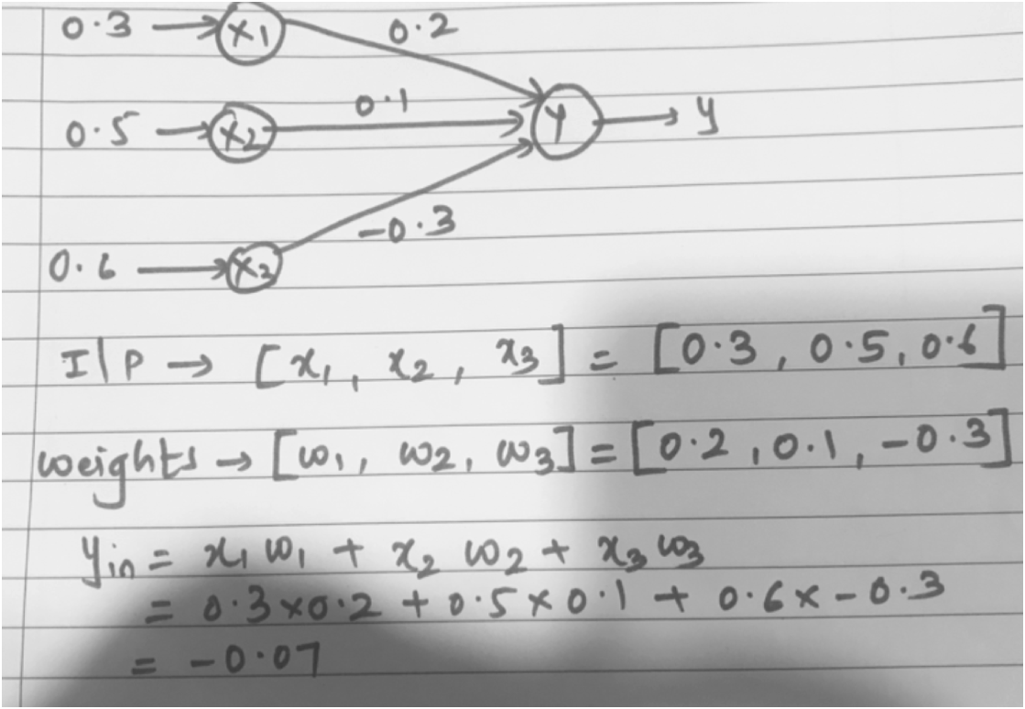
Q.1. Solution

Slide 19
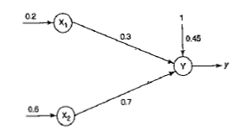
Q.2. Calculate the net input to the output neuron

Slide 20
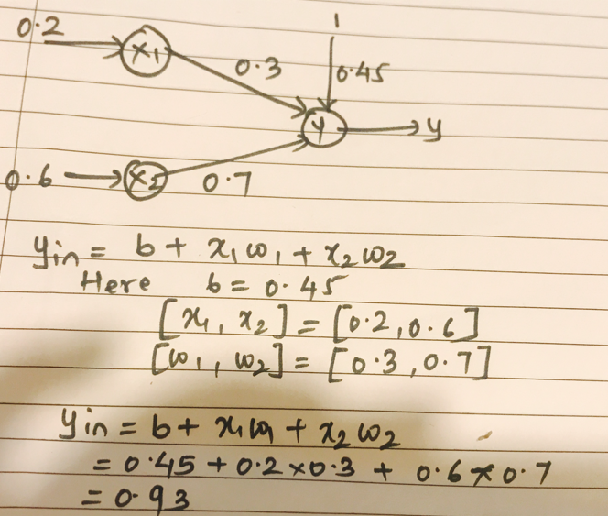
Q.2. Solution

Slide 21
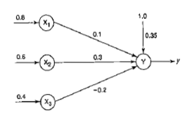
Q.3. obtain the output of the neuron Y using following activation functions: 1. binary sigmoidal 2. bipolar sigmoidal

Slide 22


Slide 23
The McCulloch-Pitts Neuron

Slide 24
Characteristics
The activation of a McCulloch Pitts neuron is binary that is at any time step the neuron may fire or may not fire.
Neurons are connected by directed weighted paths.
A connection path is excitatory if the weight on the path is positive else its inhibitory.
All excitatory connections to a neuron have the same weights.
Each neuron has a fixed threshold:
  f(n) = 1 if n >= θ
  0 if n < θ
The M-P neurons are most widely used in the case of logic functions..

Slide 25
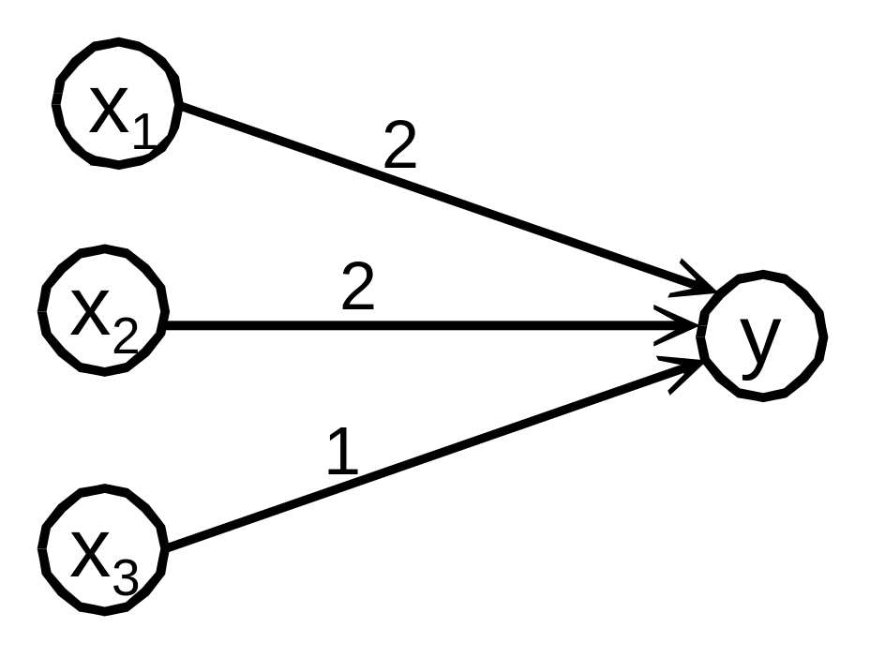
A McCulloch-Pitts Neuron

Slide 26
Examples
Train a McCulloch-Pitts neural network to perform the OR function.
Train a McCulloch-Pitts neural network to perform the AND function.
Train a McCulloch-Pitts neural network to perform the AND NOT function.
Train a McCulloch-Pitts neural network to perform the XOR function.

Slide 27

Mc-culloch Pitts Architecture
MP neuron has both excitatory as well as inhibitory connections.
It is excitatory with weights w>0 and inhibitory with weights –p(p<0)
Since firing of the output neuron is based upon the threshold , the activation function here is,

Slide 28
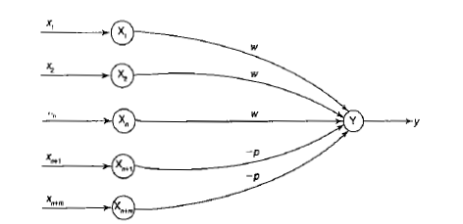

Slide 29
For inhibition to be absolute, the threshold with the activation function should satisfy the following condition,
The M-P neuron has no particular training algorithm. An analysis has to be performed to determine the
values of the weights and threshold.

Slide 30

Q.1 Implement AND function using McCulloch-Pitts neuron (take binary data).

Slide 31
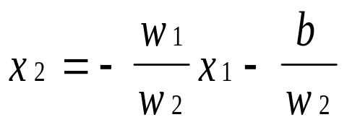
Linear Separability
A single layer neural network can only learn linear separable problems.
Multilayer nets using a linear activation function have the same problem.
In linear separable problems the region where y is positive, i.e. the neuron fires, is separated from the region where y is negative, i.e where the neuron does not fire, by the line :

Slide 32
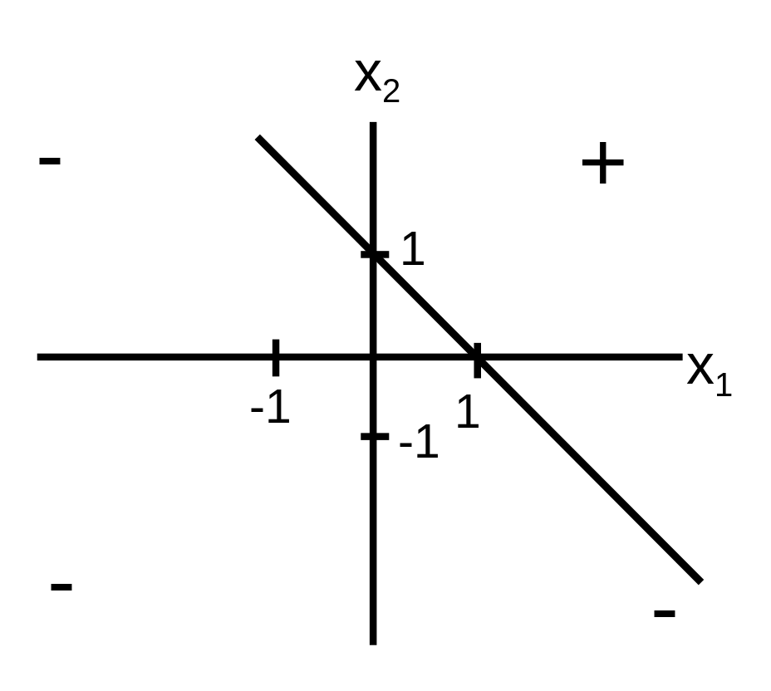
Graph for the AND Function
The AND function
is linearly separable

Slide 33
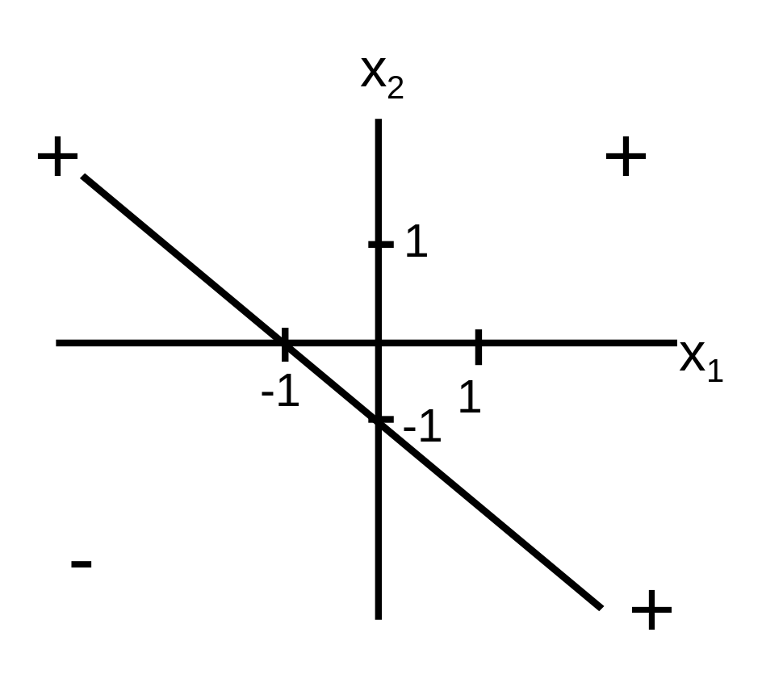
Graph for the OR Function
The OR function
is linearly separable

Slide 34
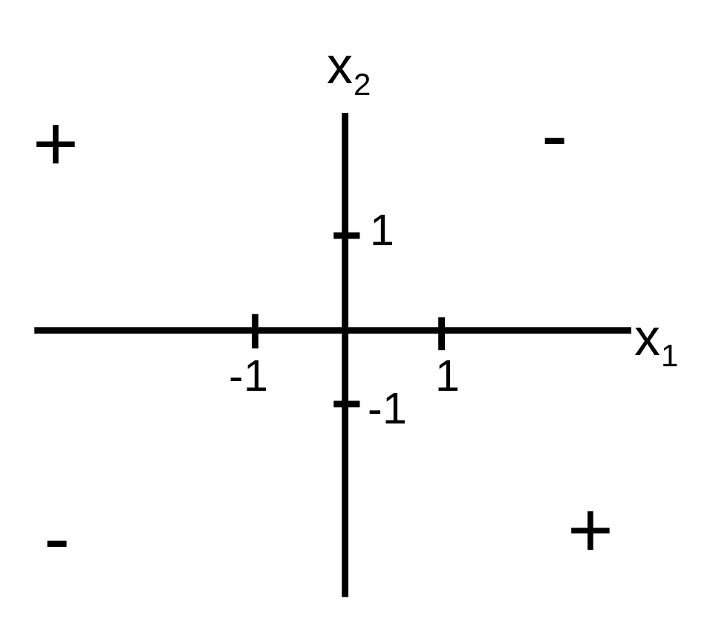
Graphic for the XOR Function
The XOR function
is not linearly separable

